Slide 1


Spatio-Temporal Methods to Handle Missing Data in Syndromic Surveillance
Nicholas B. Link M.A., Biostatistics PhD candidate, Harvard
Working with Anuraag Gopaluni M.A., Isabel Fulcher PhD, Bethany Hedt-Gauthier PhD
Tuesday, 11/28/2023
Notes:
Acknowledge previous presenters (if there are any)
Thank the organizers Thank NSF GRFP for funding

Slide 2
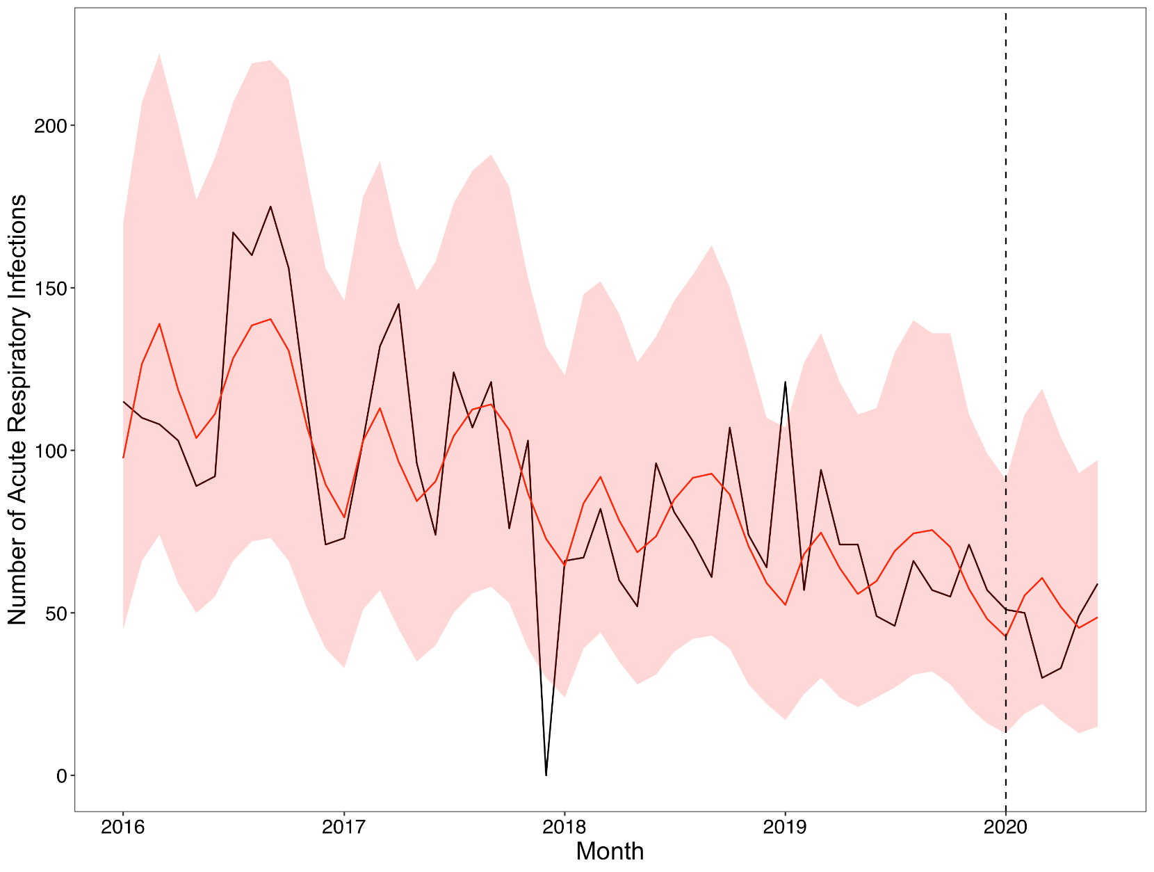

The Weinberger-Fulcher (WF) model
$\log\left(E\left[Y_{it} | β_{i},t\right]\right)=β_{i0}+β_{i1}year_{t}+\sum_{k=1}^{3}{β_{i2k}cos\left(\frac{2πkt}{12}\right)} + β_{i3k}sin\left(\frac{2πkt}{12}\right)$
Figure: Acute respiratory infections in a health care facility in Liberia
Notes:
For COVID-19, in areas with low testing, modeling of reported symptoms was used

Slide 3
Issues with this approach
Exclusion of missing data
Currently facilities with >20% incomplete data are left out
Does not take advantage spatial and temporal correlation
Notes:
REFERENCE

Slide 4
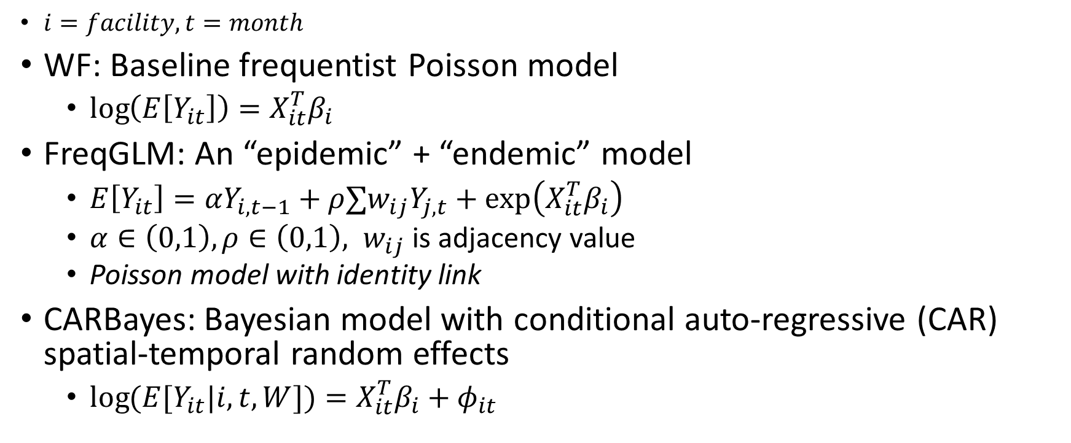
Models
$i=facility, t=month$
WF: Baseline frequentist Poisson model
$\log\left(E\left[Y_{it}\right]\right)=X_{it}^{T}β_{i}$
FreqGLM: An “epidemic” + “endemic” model
$E\left[Y_{it}\right]=αY_{i,t−1}+ρ∑w_{ij}Y_{j,t}+\exp\left(X_{it}^{T}β_{i}\right)$
$α∈\left(0,1\right), ρ∈\left(0,1\right), w_{ij}$is adjacency value
Poisson model with identity link
CARBayes: Bayesian model with conditional auto-regressive (CAR) spatial-temporal random effects
$\log{(E[Y_{it}|i,t,W])}=X_{it}^{T}β_{i}+φ_{it}$
Notes:
$$w_{ij}=\left\{\begin{aligned}\frac{1}{n_{i}} facility i is adjacent to j \\ 0 otherwise\end{aligned}\right.$$

Slide 5
Simulation Overview
Simulate data over 49 months for 20 facilities
Generate data according to the WF, freqGLM, and CARBayes models
Simulate missing data with MCAR, MAR (spatio-temporal), and MNAR (higher values more likely to be missing)

Slide 6
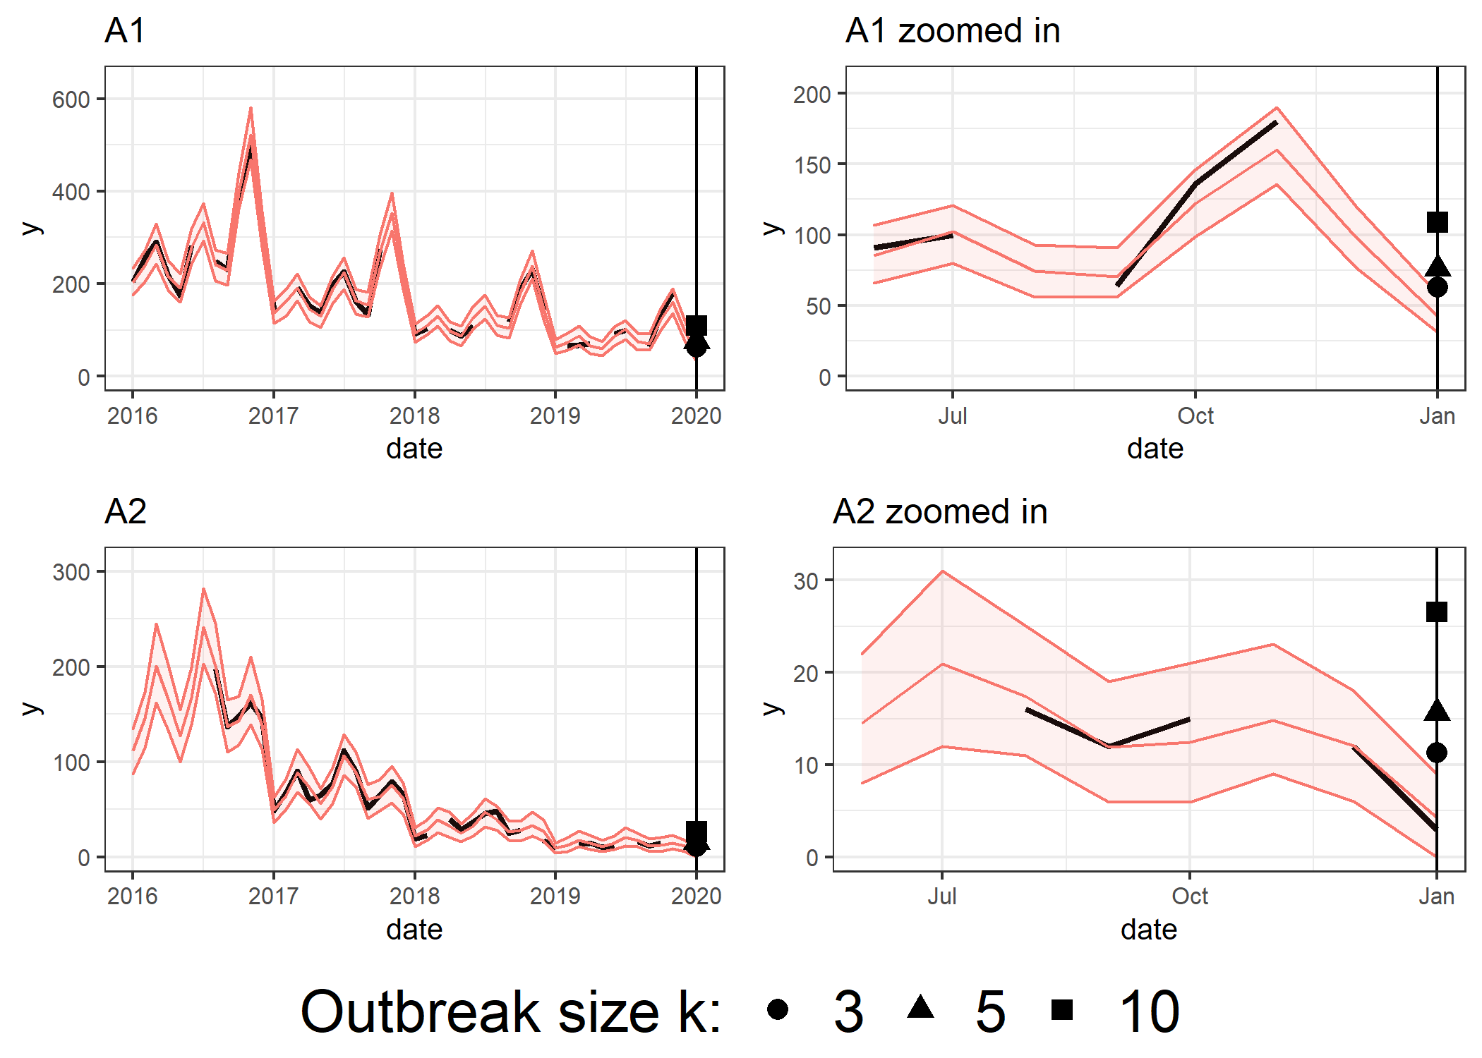
Outbreak analysis
True outbreak: A point significantly above the expected trend
A k-outbreak: A point k standard deviations above the expected value
Model detection of outbreak: point above model’s 95% prediction interval
Sensitivity-k: proportion of k-outbreaks correctly classified
Specificity: proportion of non-outbreak points that are correctly classified
Figure: WF model results from one simulation under WF DGP 20% MCAR

Slide 7
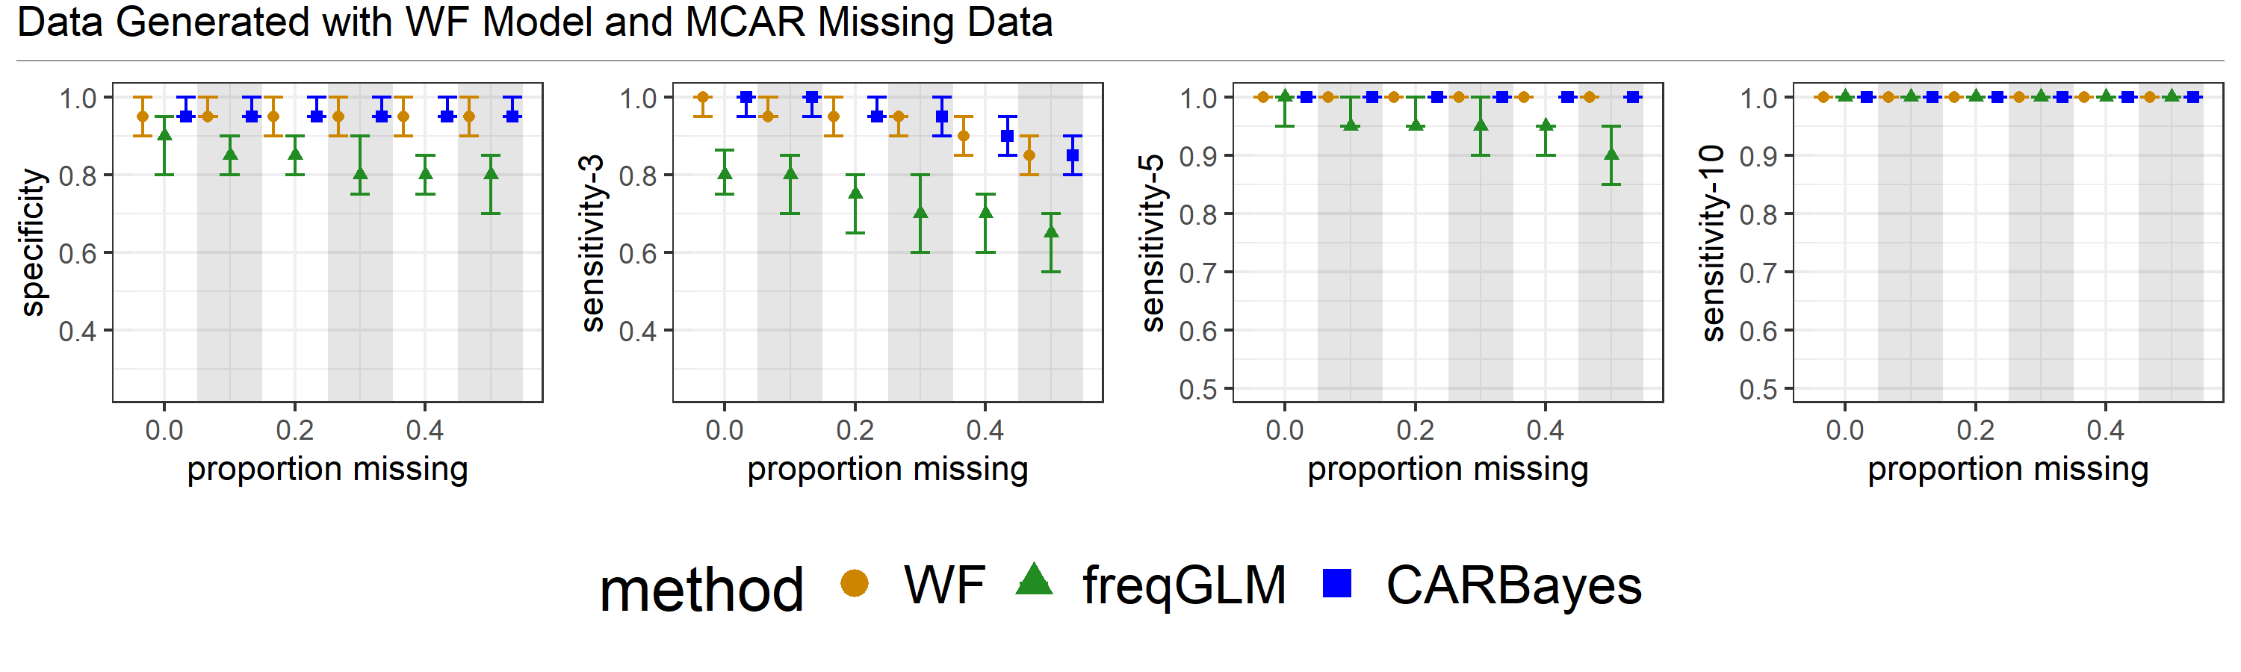
Results from models on data generated by WF
Notes:
- Plots of specificity and sensitivity
- Results from 3 models
- 1000 simulations, median value, 25% and 75% quantiles
- WF and CAR have identical specificity and sensitivity -> CAR correctly identifying no spatial and temporal correlation
- freqGLM lower specificity and sensitivity -> Not able to identify no spatial and temporal correlation.

Slide 8
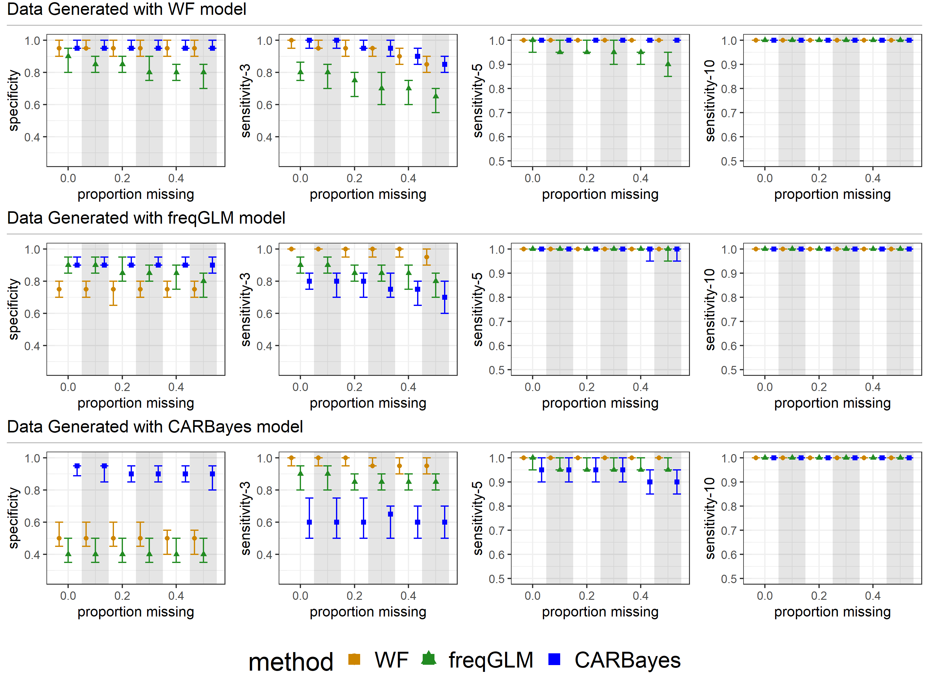
Analysis Across Data Generation Mechanisms
MCAR missing data
Notes:
Main Points:
1) For freqGLM DGP, CAR has the highest specificity but lowest sensitivity to detect low outbreaks
2) For CAR DGP, CAR has higher specificity and lower sensitivity. WF and freqGLM have too tight prediction intervals/ narrow uncertainty
3) CAR is the only model that has necessary specificity to not return a lot of false positives
Though it’s sensitivity to detect small outbreaks is worse.
4) For high outbreaks, all the models detect them

Slide 9
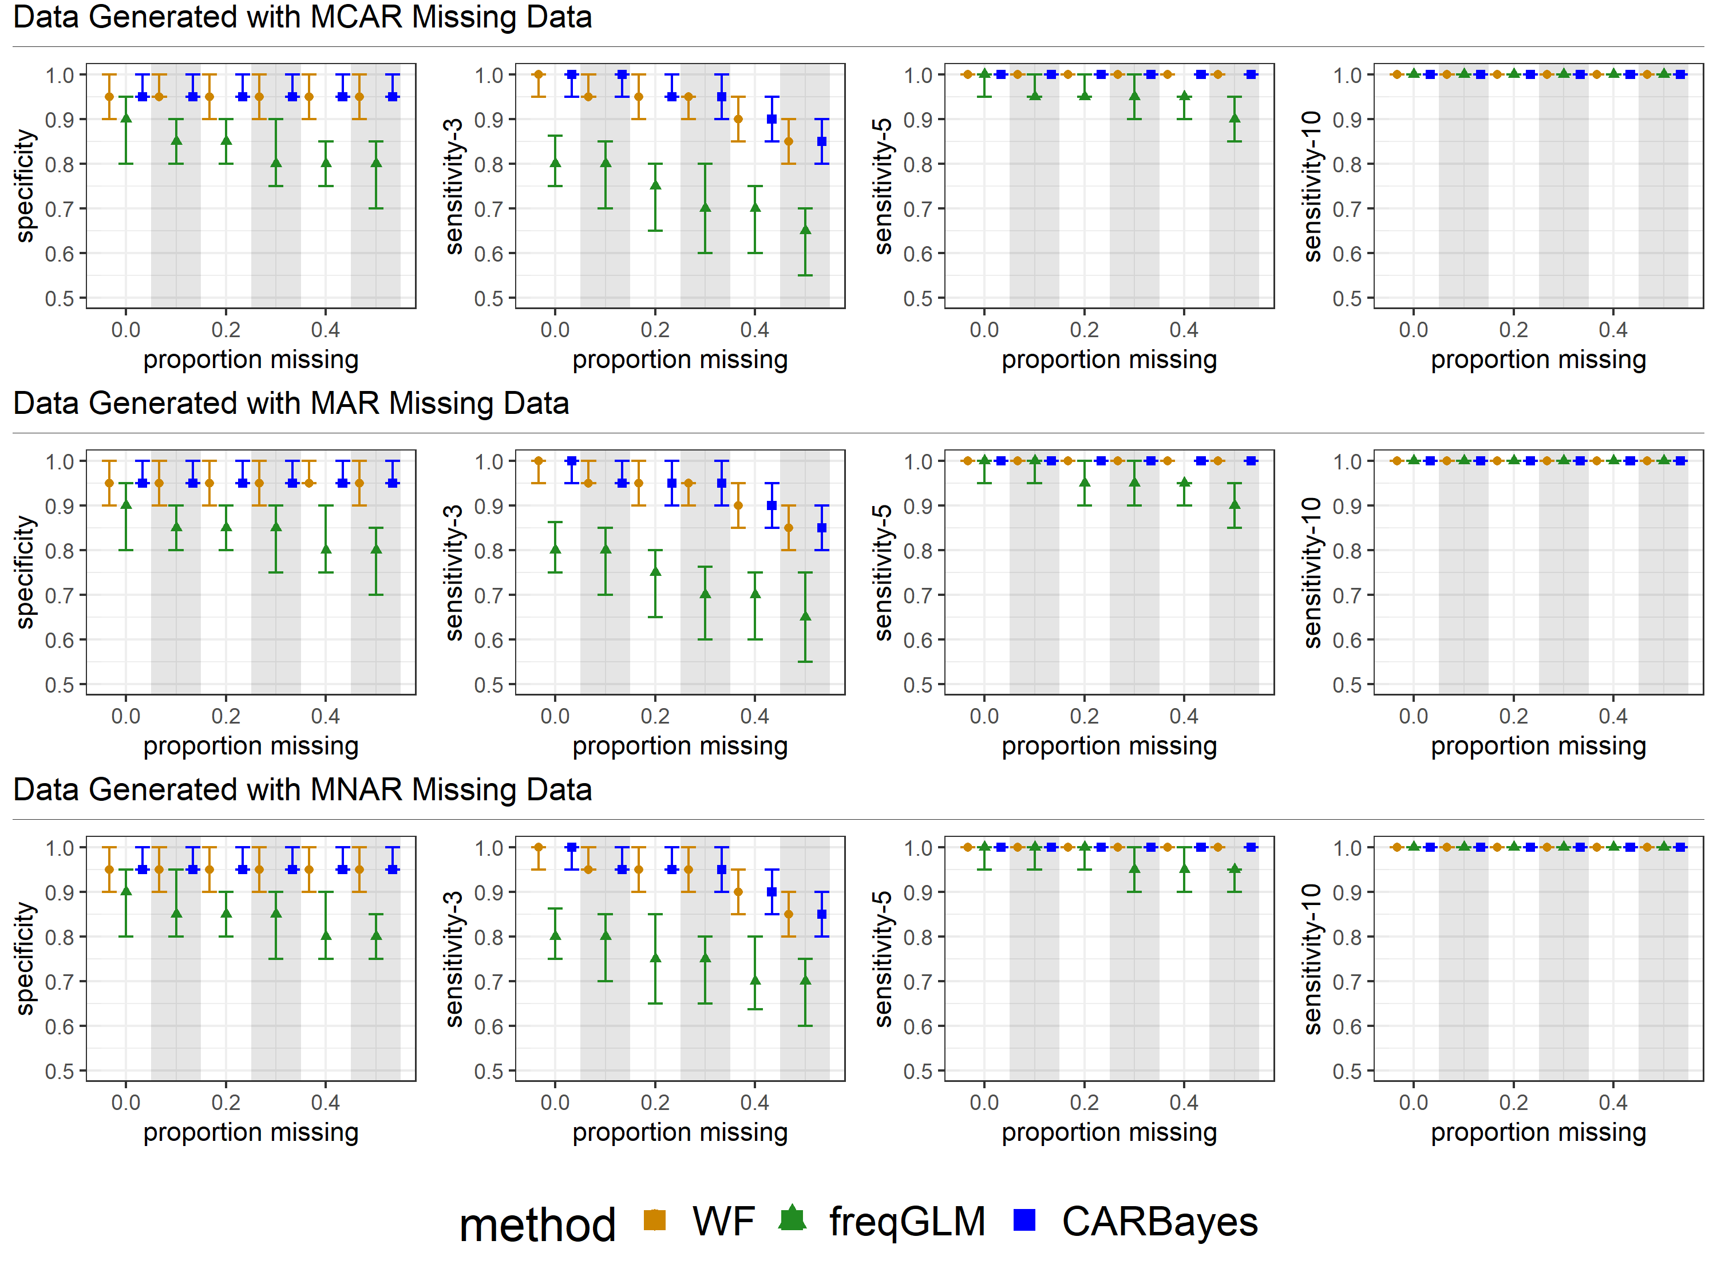
Analysis Across Missing Data Mechanisms
Data generated under WF
Notes:
Main points:
The type of missing data doesn’t have much impact on results
Surprising that even MNAR the specificity is ok, though the sensitivity is not surprising.

Slide 10
EXTRA SLIDES

Slide 11
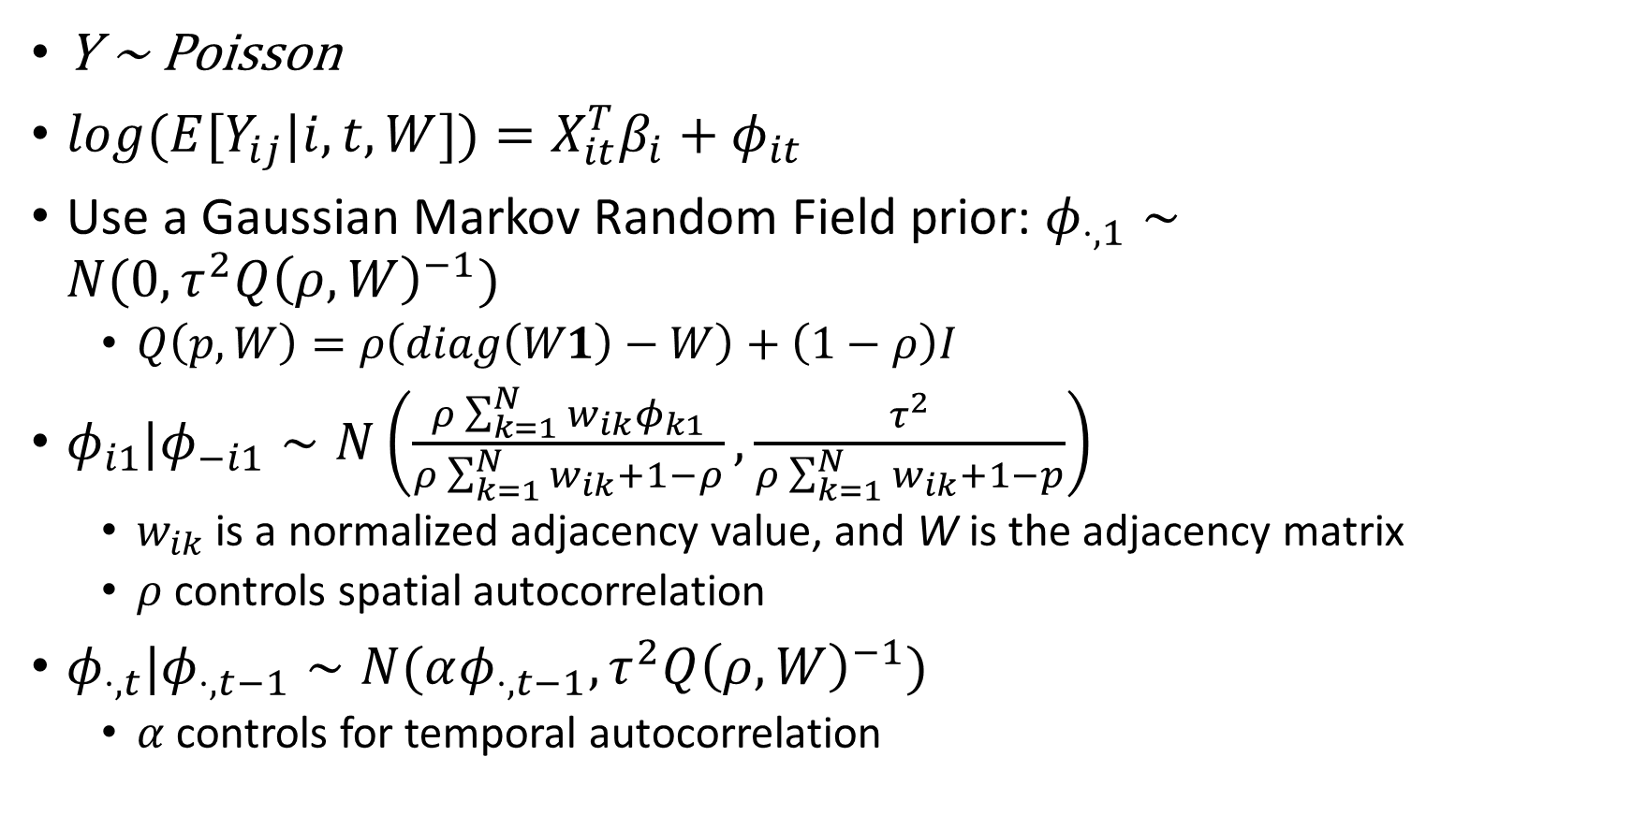
Bayesian Conditional Autoregressive Priors
Y ~ Poisson
$log(E[Y_{ij}|i,t,W])=X_{it}^{T}β_{i}+φ_{it}$
Use a Gaussian Markov Random Field prior: $φ_{⋅,1}∼N(0, τ^{2}Q{\left(ρ,W\right)}^{−1})$
$Q\left(p,W\right)=ρ\left(diag\left(W1\right)−W\right)+\left(1−ρ\right)I$
$φ_{i1}|φ_{−i1}∼N\left(\frac{ρ\sum_{k=1}^{N}{w_{ik}φ_{k1}}}{ρ\sum_{k=1}^{N}{w_{ik}}+1−ρ},\frac{τ^{2}}{ρ\sum_{k=1}^{N}{w_{ik}}+1−p}\right)$
$w_{ik}$ is a normalized adjacency value, and W is the adjacency matrix
$ρ$ controls spatial autocorrelation
$φ_{⋅,t}|φ_{⋅,t−1}∼N(αφ_{⋅,t−1},τ^{2}Q{\left(ρ,W\right)}^{−1})$
$α$ controls for temporal autocorrelation

